Slide 1
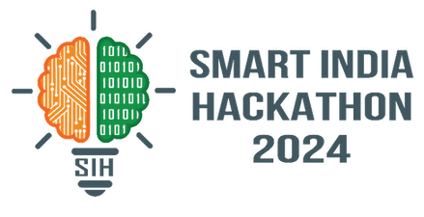
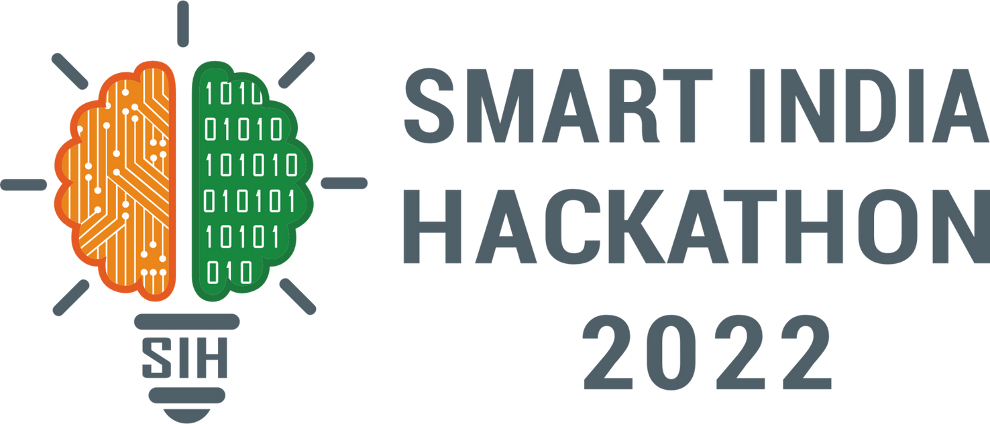
SMART INDIA HACKATHON 2025
TITLE PAGE
Problem Statement ID- SIH25067
Problem Statement Title- Proposal for Design and Development of application on Heavy Metal Pollution indices
Theme- Miscellaneous
Problem Statement Category- Software
Team ID-
Team Name- Code4Tomorrow
1

Slide 2

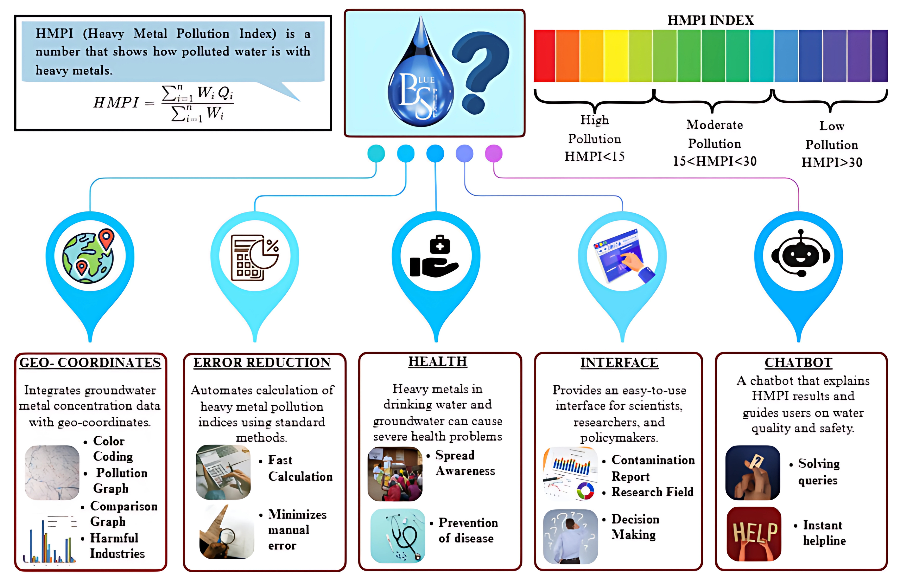



IDEA DETAILS
Code4Tomorrow
USP
Integrated real - time geo- spatial mapping and analytics.
User support and guide
Real time query resolution
Feedback and Response
Using many possible scenarios to better analyse and understand health issues caused by heavy metal.
2
@SIH Idea submission- Template

Slide 3






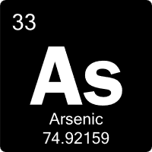
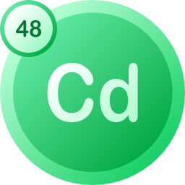
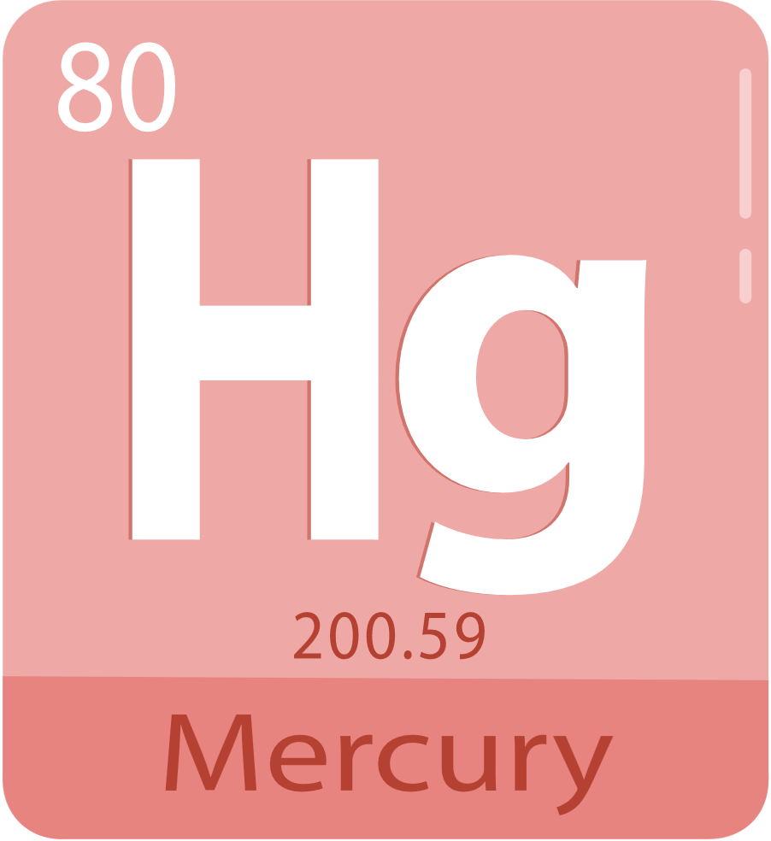


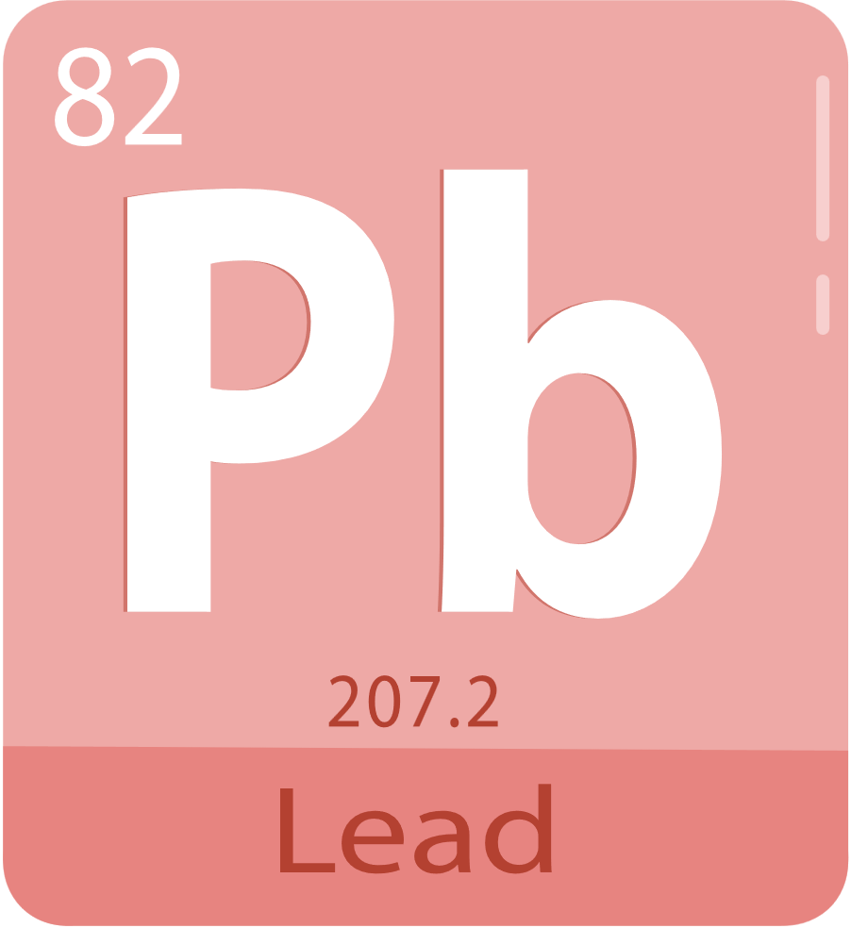
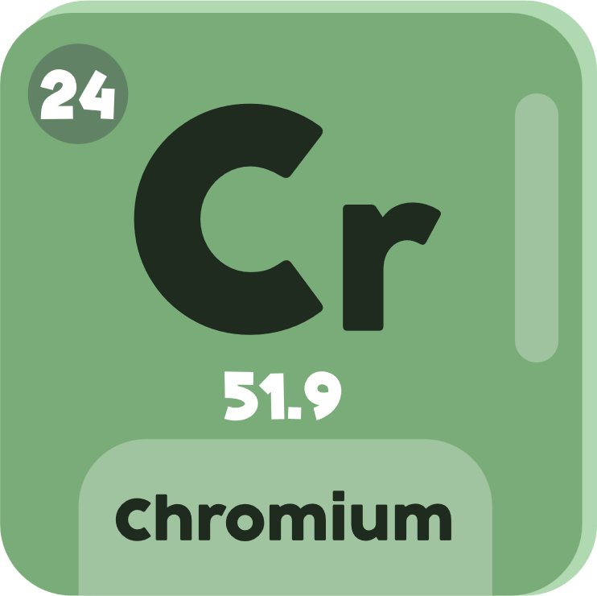


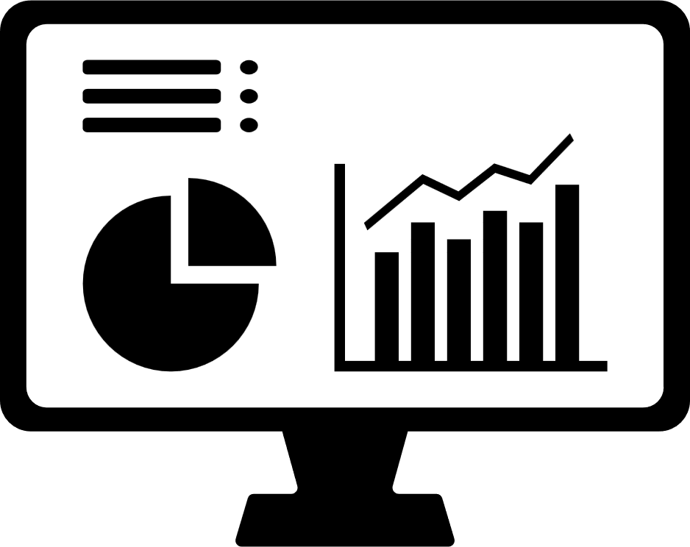








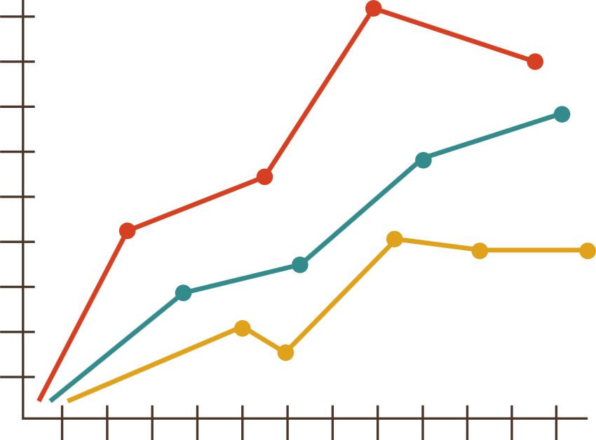






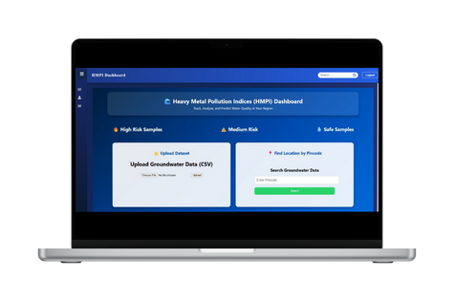








TECHNICAL APPROACH
Code4Tomorrow
• Government Bodies
• Researchers
• Scientist
TECH STACK
User opens
Application (URL)
Metal Data
DATABASE
Authentication
(Log In/ Sign Up)
Chatbot
Module
Dashboard Pgae +
Chatbot Integration
FRONTEND
Question & Answer
Upload Module
Upload data (CSV/Form)
Preprocessed data
Visualization
Yearly Trends-Bar/Line Charts
Compare metals
Distribution Map
Heavy Metal data on leaflet map
Marked contaminated location
BACKEND
WEBSITE LINK
Data Stored
(Backend in MongoDB)
Insights and Reports
Top ‘n’ samples
Status alert
DEPLOYMENT
ML Engine
Predict the risk area
Classify save vs unsafe
3
@SIH Idea submission- Template

Slide 4




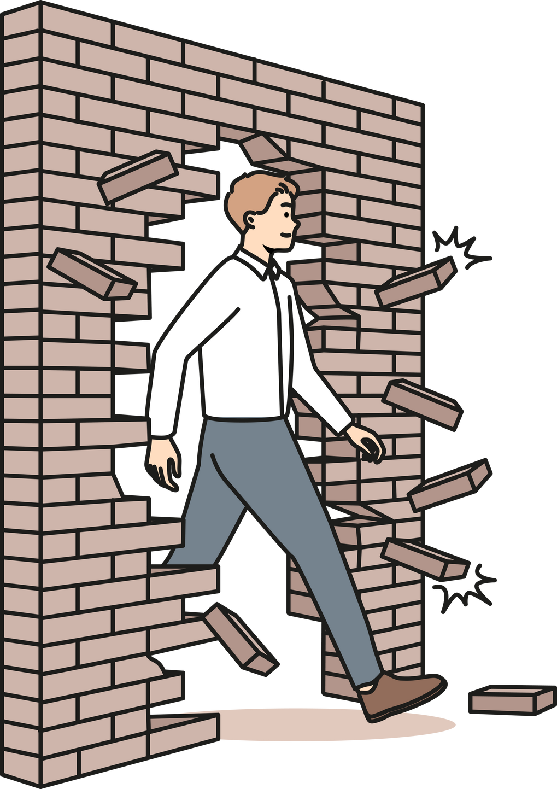
FEASIBILITY AND VIABILITY
Code4Tomorrow
FEASIBILITY
Technical: Can be built using existing tools and technologies like data analysis, mapping, and automation.
Operational: Easy for researchers, policymakers, and health officials to use without deep technical skills.
Resource: Requires basic computing resources and existing groundwater data—no huge investment needed.
VIABILITY
Economic: Saves money by reducing manual work and errors, lowering long-term costs.
Environmental: Supports long-term sustainability by preventing water pollution and protecting ecosystems.
Scalability: Can be expanded to cover larger regions and more data over time.
CHALLENGES
Data Issues: Limited availability, inconsistent formats, and missing geo-coordinates can affect accuracy.
Technical Challenges: Integration of IoT, real-time data, and predictive models may be complex and resource-intensive.
Financial Constraints: Advanced features and long-term maintenance require sustainable funding.
Operational Limitations: User training, internet connectivity, and system adoption in remote areas may pose hurdles.
Regulatory & Ethical Risks: Data privacy compliance and adapting to changing environmental policies are essential.
SOLUTION
Data Issues: Collaborate with agencies, use data cleaning tools, and validate geo-coordinates.
Technical challenges: Use modular architecture, cloud for scalability, and add AI/ML features gradually.
Financial constraints: Begin with an MVP, seek government/NGO funding, and use open-source tools.
Operational limitations: Provide training, enable offline data entry with syncing, and ensure mobile-friendly access for remote areas.
Regulatory & ethical risks: Comply with data privacy laws, keep pollution limits configurable, and maintain transparent data policies.
4
@SIH Idea submission- Template

Slide 5

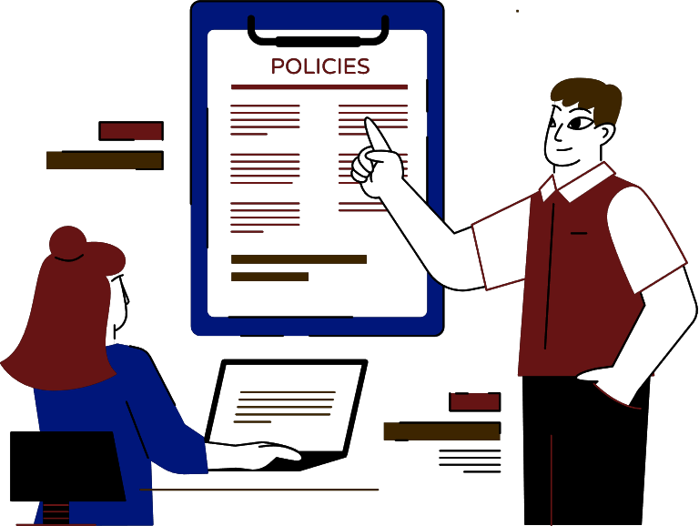
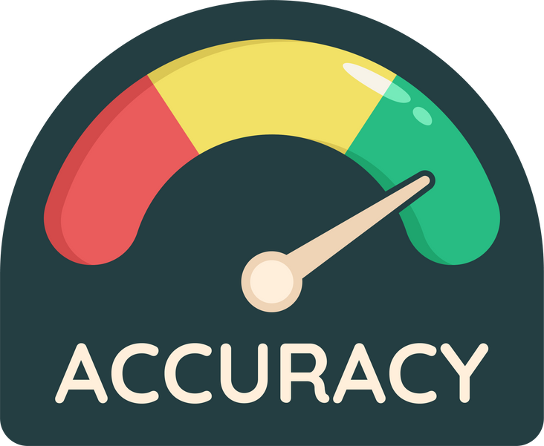


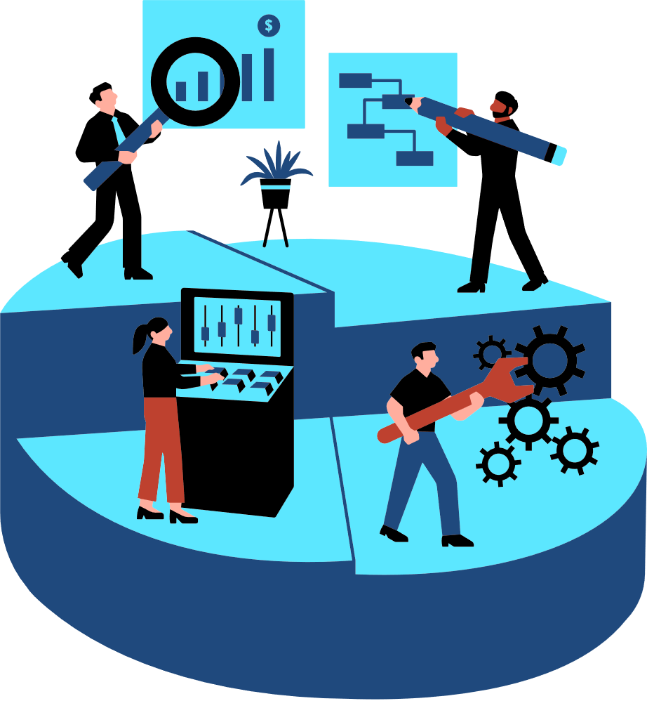
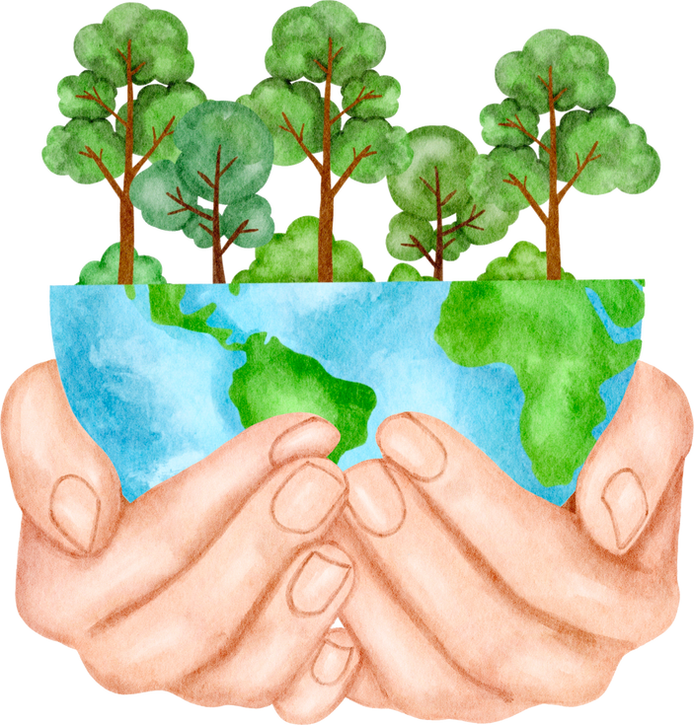
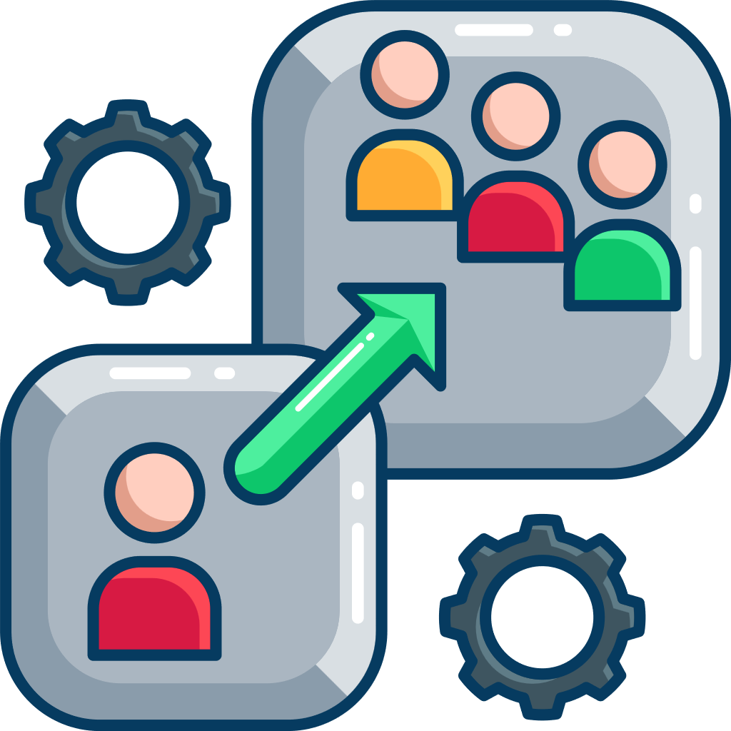

IMAPCTS AND BENIFITS
Code4Tomorrow
IMAPCTS
BENEFITS
Public Health Protection
Early detection of heavy metal contamination reduces risks of chronic diseases (kidney damage, neurological disorders, cancer).
Policy Support
Provides scientific evidence for government agencies to frame water safety regulations and pollution control strategies.
Accuracy & Efficiency
Automated standardized calculations save time and reduce human error compared to manual methods.
User Accessibility & Data Support: Simplifies complex data for all users and enables evidence-based decisions for water safety and resource management.
Operational Efficiency
Automates complex index calculations, saving time for researchers and reducing dependence on manual computations.
Environmental Monitoring
Enables continuous tracking of groundwater quality across regions, identifying hotspots of contamination.
Scalability & Integration
Easily integrates with GIS, IoT sensors, and can expand to monitor other pollutants.
Sustainability & Impact
Supports long-term groundwater management and aligns with Sustainable Development Goal for clean water and sanitation.
5
@SIH Idea submission- Template

Slide 6
REASEARCH AND REFERENCES
Code4Tomorrow
RESEARCH
REFERENCES
“A Novel Approach for Indexing Heavy Metals Pollution…”
(Link)
“Perspectives of heavy metal pollution indices…”
(sciencedirect.com)
“Human health risk assessment of drinking water using heavy metal pollution index: a GIS-based investigation…”
(link.springer.com)
https://pubs.acs.org/doi/10.1021/bk-2023-1456.ch001
https://www.researchgate.net/publication/361308605_Application_of_Heavy_metals_pollution_index_on_two_types_of_constructed_wetland
https://pmc.ncbi.nlm.nih.gov/articles/PMC10725677/
https://www.sciencedirect.com/science/article/pii/S2950395723000115#:~:text=Our%20estimate%20of%20the%20Heavy,the%20lifting%20of%20lockdown%20restrictions
6
@SIH Idea submission- Template

